Slide 1
PIN DIODE
Rfmw ise component

Slide 2
GROUP MEMBERS
Prathamesh Dixit B-41
Bharat Borhade B-44

Slide 3
BASICS OF PIN DIODE
PIN diode offers high resistance
IT has lower capacitance due to intrinsic layer
IT has Higher Reverse breakdown voltage

Slide 4
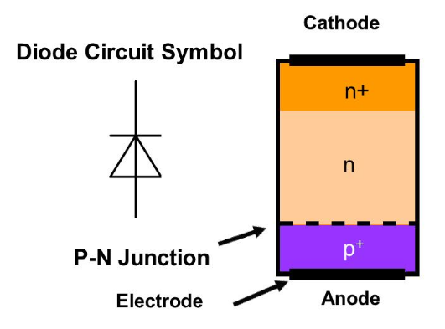
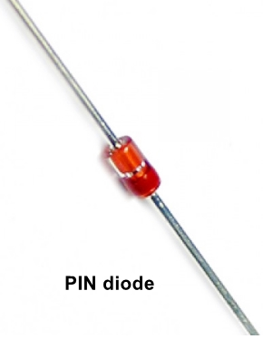
SYMBOL AND COMPONENT

Slide 5
BIASING
When the PIN diode is subjected to forward bias, the depletion region at the p-n junction reduces
The PIN diode acts as a variable resistance when operated in forward bias
When the pin diode is in reverse biased condition, the width of the depletion region increases
It acts as Variable capacitance in reverse bias

Slide 6
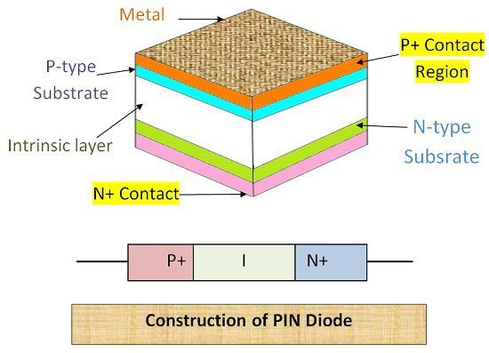
INTERNAL STRUCTURE

Slide 7
CHARACTERISTICS
Low Capacitance
High Breakdown Voltage
Sensitive to Photodetection

Slide 8
APPLICATIONS
High Voltage Rectifier
RF Switch
Photo Detector
Variable Attenuator

Slide 9
THANK
YOU

